Slide 1

XN Project
Sarah Deitch, Bowen Ma, Erik Wilder, Muskan Yadav

Slide 2
Data Preparation

Slide 3
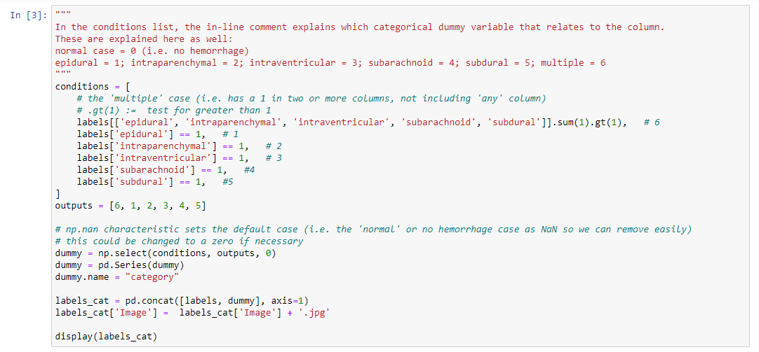
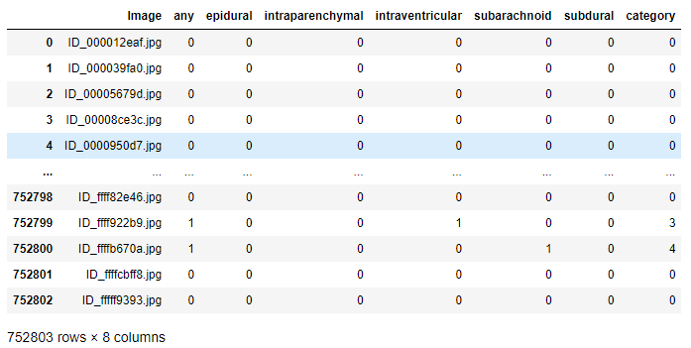

Slide 4
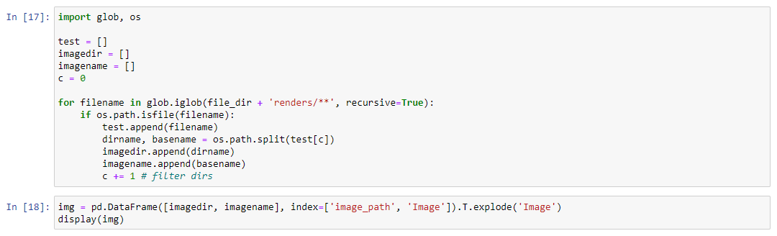
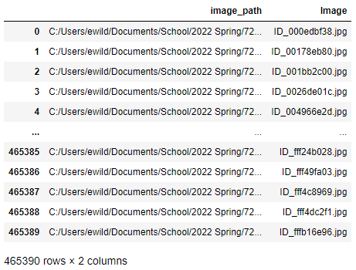

Slide 5
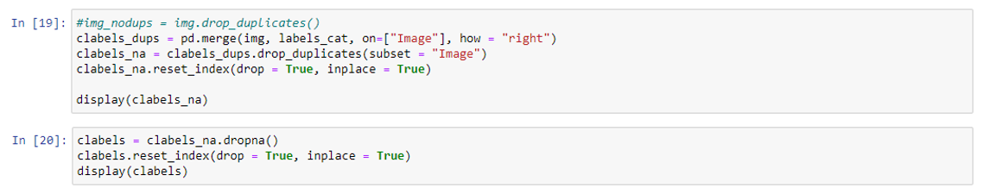
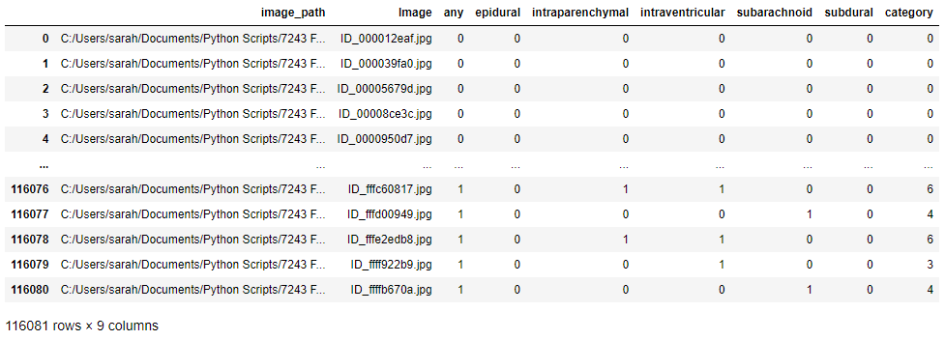

Slide 6
Logistic, LDA, & QDA
1-Layer Images

Slide 7
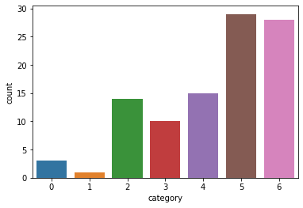

Sampled
For the Logistic, LDA, & QDA – we had sampled down to only 100 images to see if everything worked as expected

Slide 8
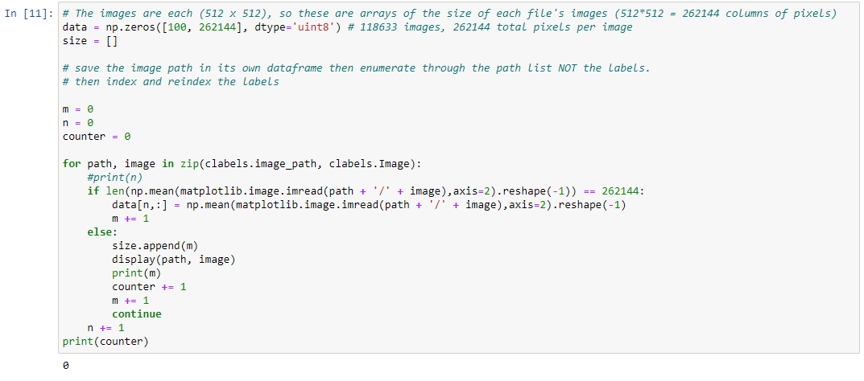

Slide 9
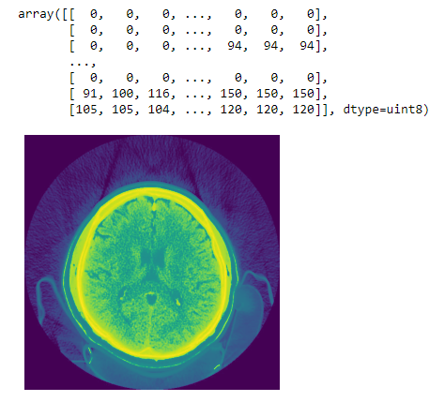
For the Logistic, LDA, & QDA – Images were imported with 1 layer (512, 512, 1)

Slide 10
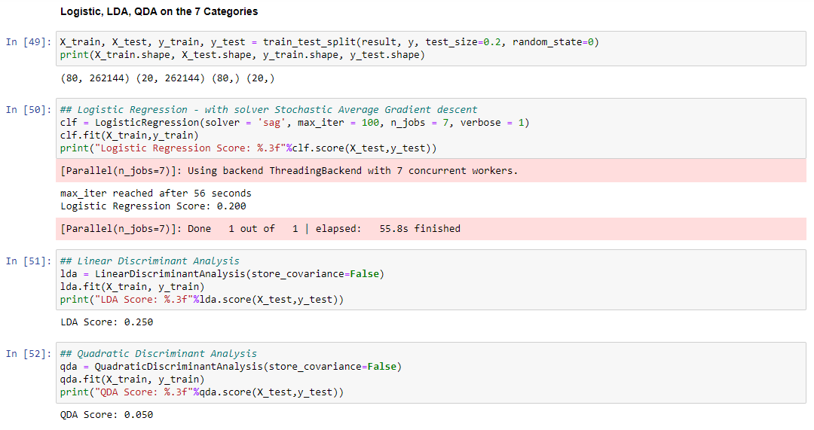

Slide 11
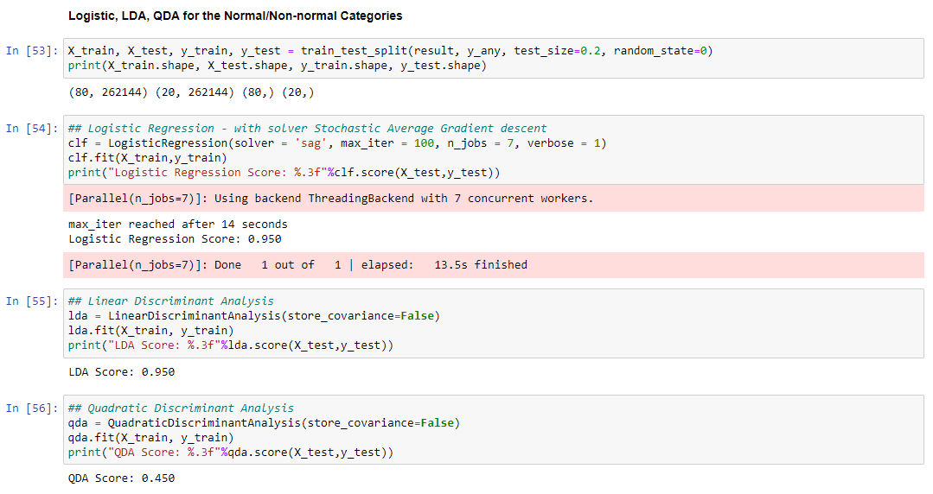

Slide 12
CONVOLUTED NEURAL NETWORK
3-Layer Images

Slide 13
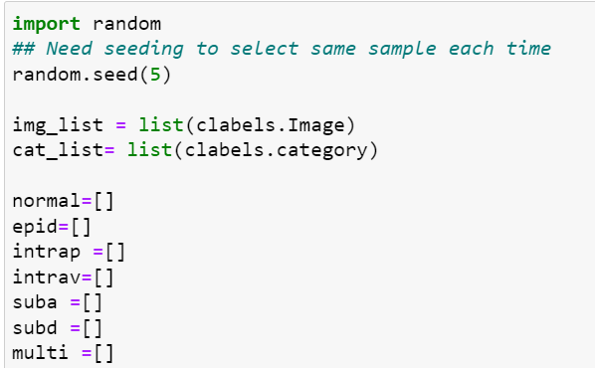
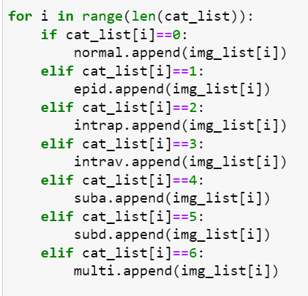
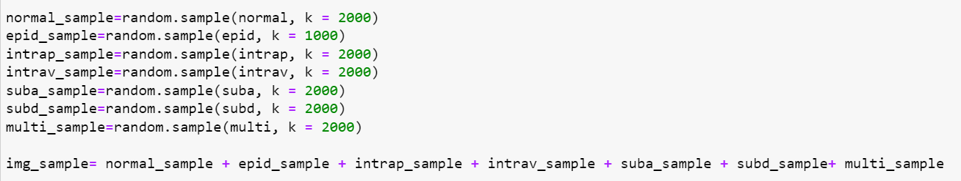
Getting a random sample of different image types

Slide 14
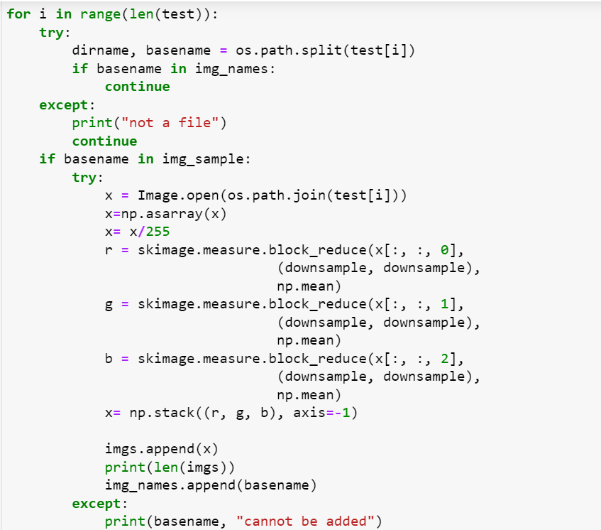
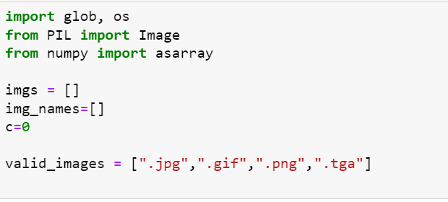
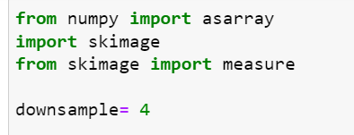
Downsampling

Slide 15
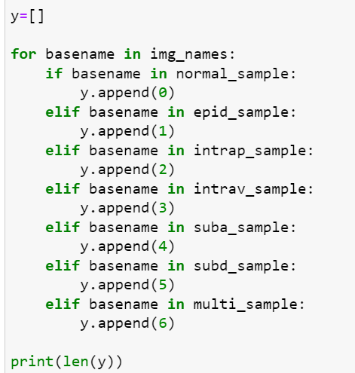
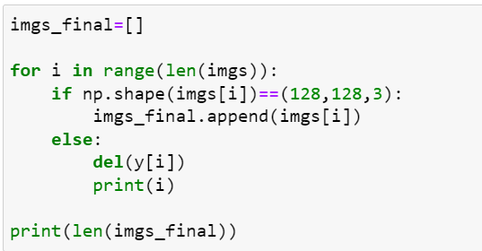
Removing incorrectly shaped images

Slide 16
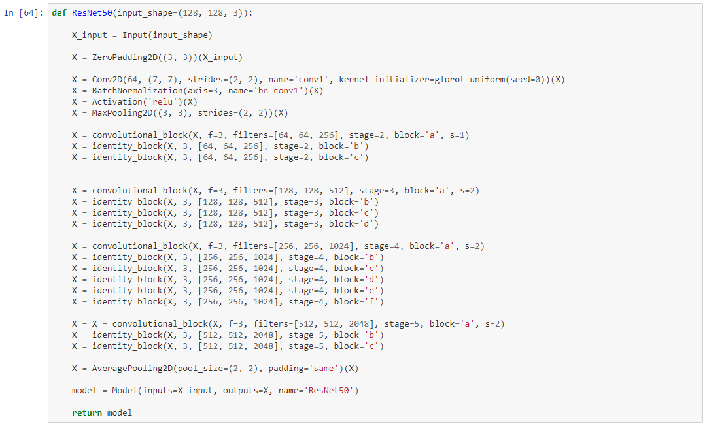
ResNet50

Slide 17
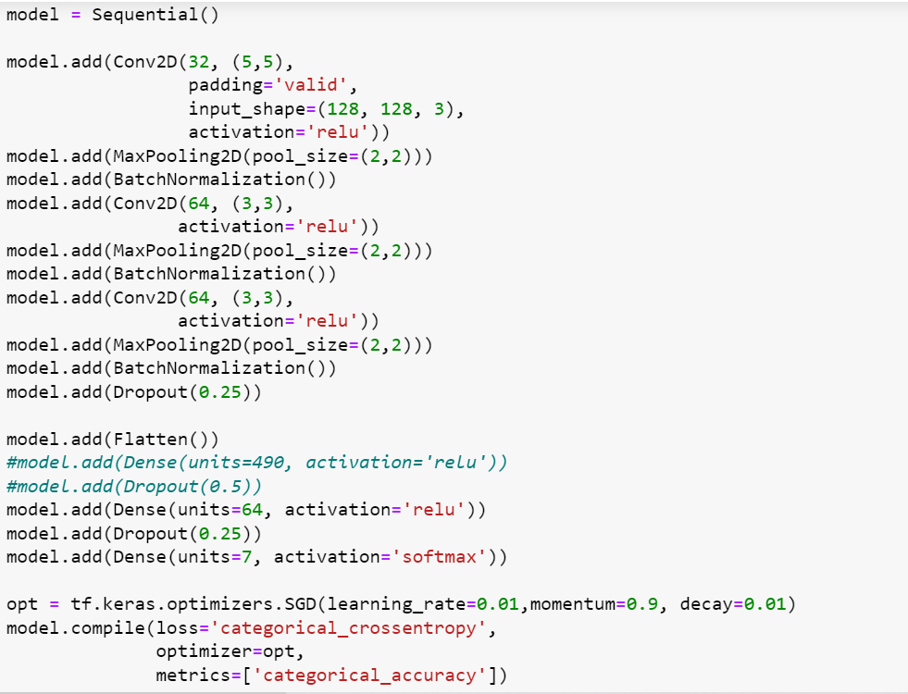
CNN Model

Slide 18
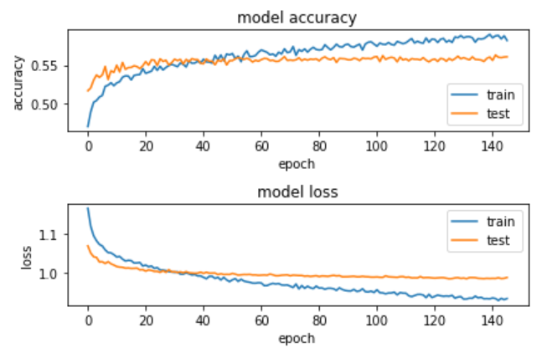

Slide 19
Logistic, LDA, & QDA
3-Layer Images

Slide 20
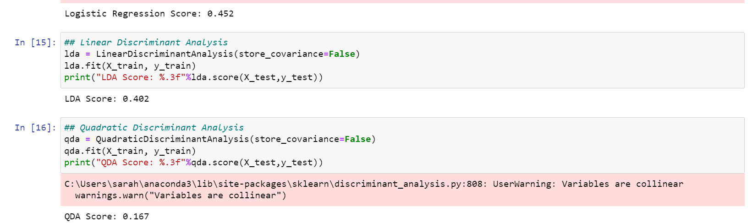

Slide 21
Categorized Conclusion
Our best Test Accuracy result came from the Constructed CNN for Downsampled 3-Layer Images:
0.5893

Slide 22
Segmentation

Slide 23
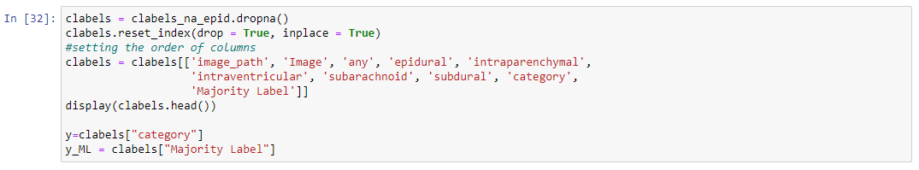
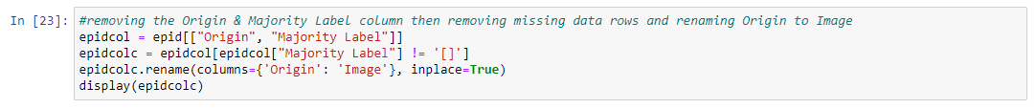
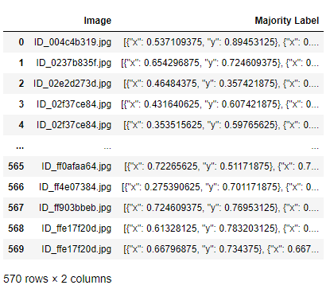
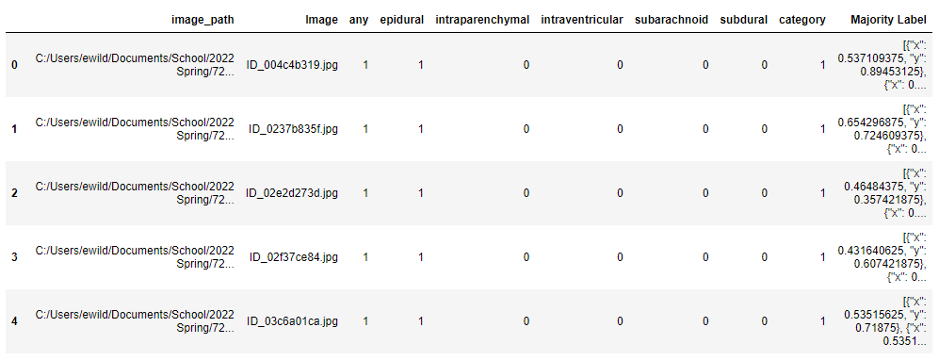
Segmentation Attempt

Slide 24
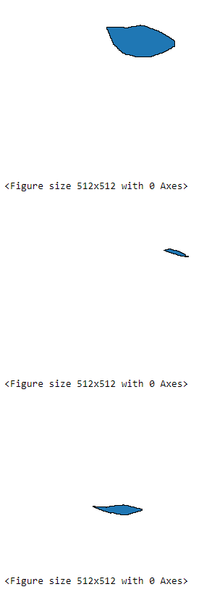
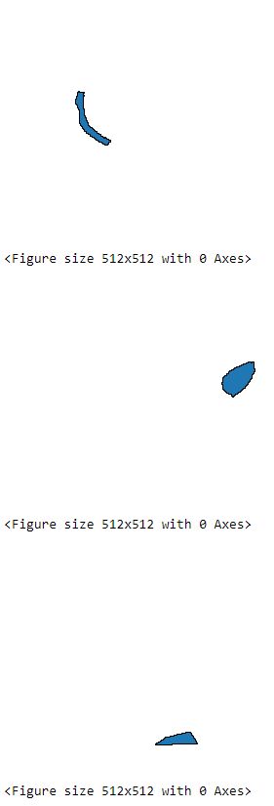
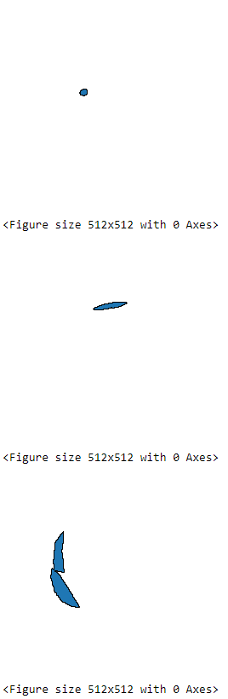
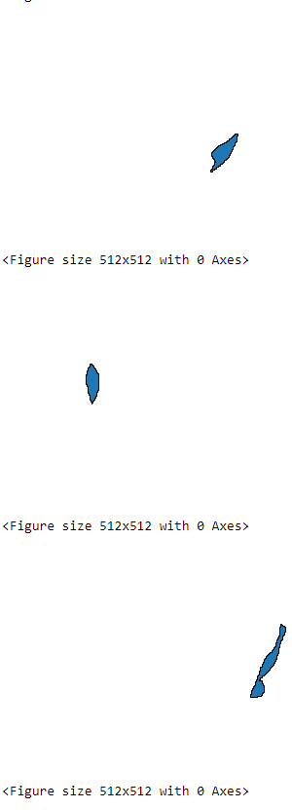

Slide 25
Discussion
NOW: We use 7 categories for classification.
NEW: We consider using only 5 diagnoses for classification, and each class is given a probability.
For example: 0.8, 0.2, 0.1, 0.2, 0.3.
Then give a standard such as 0.5. Above this probability think he has this disease. In this example, the person has disease 1.
TWO Advantages:
1. Avoid the interference of different multis.
2. Which kind of multi can be directly classified

